Slide 1
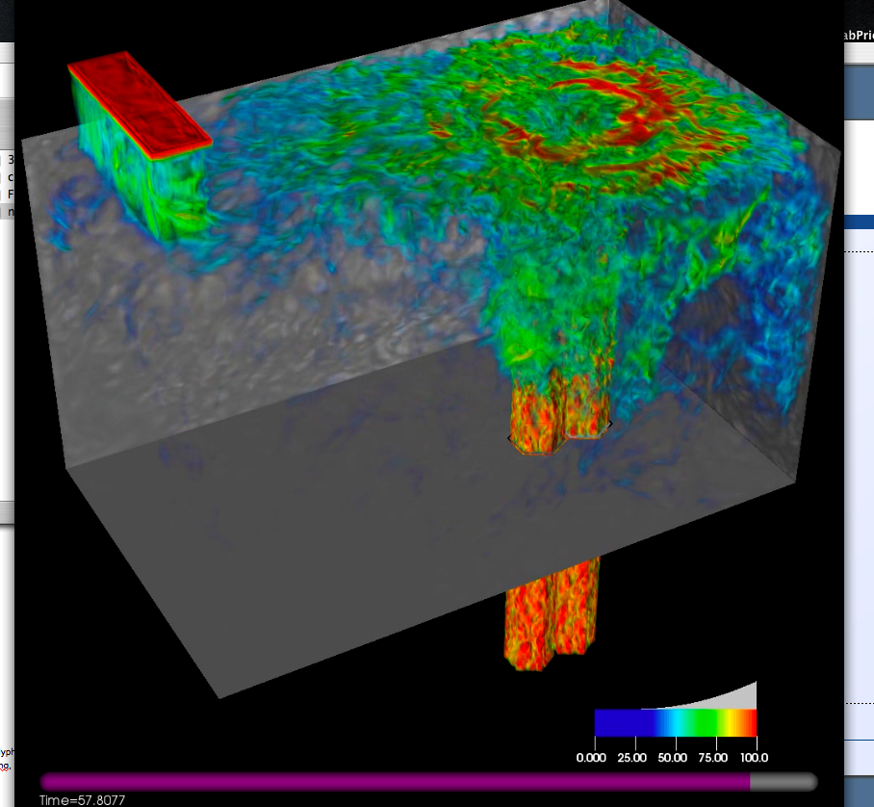
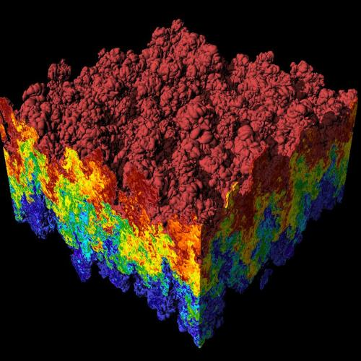
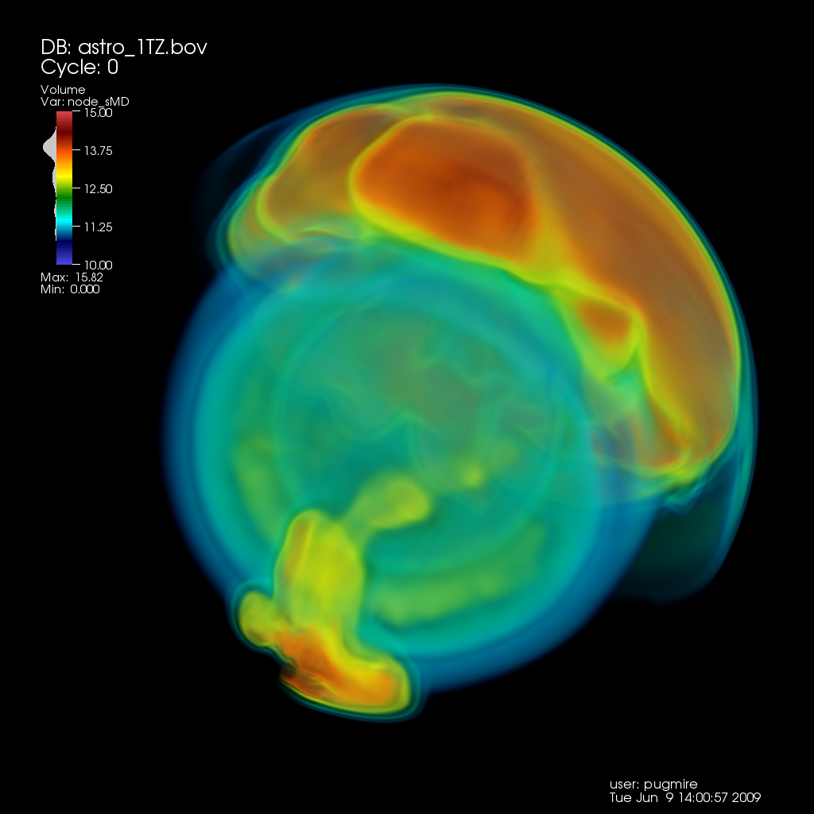
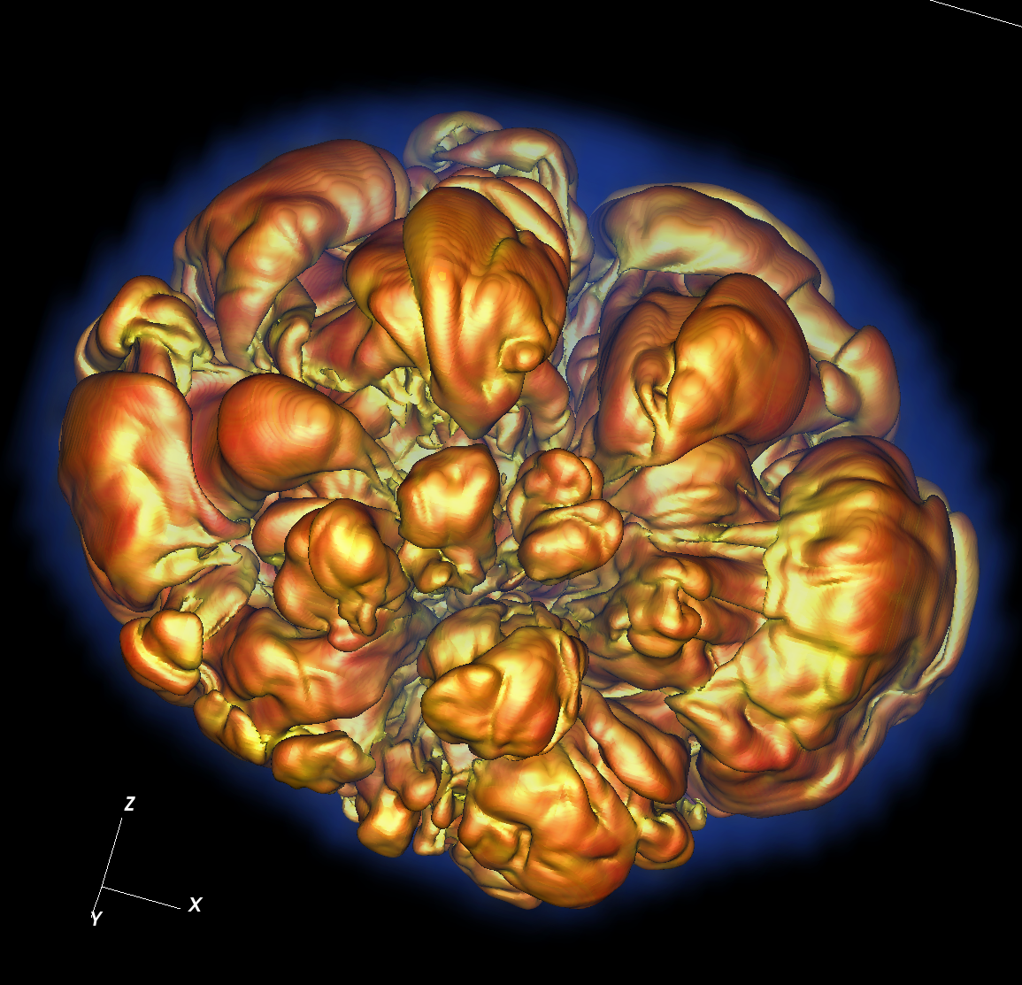
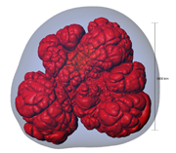
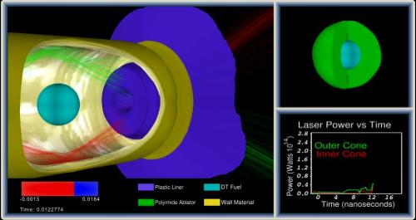
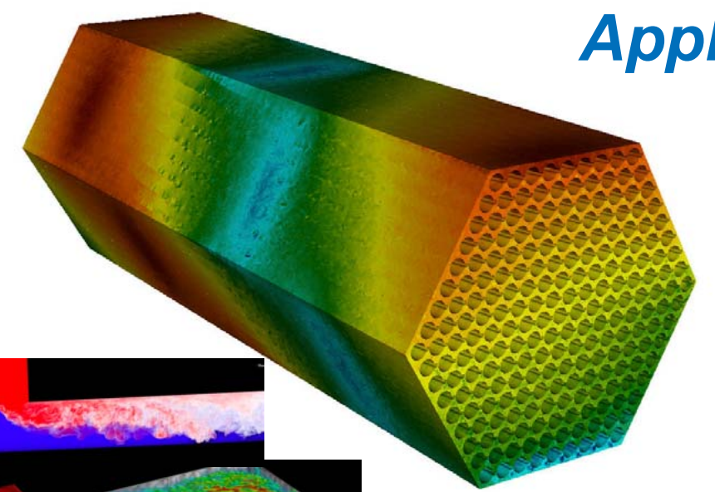
CIS 441/541: Intro to Computer Graphics Lecture 11: Even More OpenGL!
February 21, 2019
Hank Childs, University of Oregon

Slide 2
Office Hours: Week 7
Monday: 1-2 (Roscoe)
Tuesday: 1230-115 (Hank)
Tuesday: 1-2 (Roscoe)
Wednesday: 1-3 (Roscoe)
Thursday: 1130-1230 (Hank)
Friday: 1130-1230 (Hank)

Slide 3
Timeline (1/2)
1F: assigned Feb 7th, due Feb 19th
→ not as tough as 1E
2A: posted now, due Feb 21st Feb 23rd
→ you need to work on both 1F and 2A during Week 6 (Feb 11-15)
2B: posted now, due Feb 27th
YouTube lectures for Feb 12th and 14th

Slide 4
Timeline (2/2)
Sun | Mon | Tues | Weds | Thurs | Fri | Sat
Feb 3 | Feb 4 | Feb 5 Lec 8 | Feb 6 1E due | Feb 7 Begin 1F, begin 2A | Feb 8 | Feb 9
Feb 10 | Feb 11 | YouTube | Feb 13 | YouTube?? | Feb 15 | Feb 16
Feb 17 | Feb 18 | Feb 19 1F due | Feb 20 | Feb 21 2A due, begin 2B | Feb 22 | Feb 23 2A due

Slide 5
Midterm
Date: Tues Feb 26th
Considering different plan: 25 & 5
Still no feedback received
Midterm worth 30 points, no quiz on Week 10
Details:
No notes.
Not expected to memorize Phong shading equation.
Will be derived directly from 1A-1F, 2A. Not 2B.

Slide 6
Midterm
Questions will mostly derive from Project 1A, 1B, 1C, 1D, 1E, 1F, 2A
Example: here’s a triangle, what pixels does it contribute to?
Example: write GL program to do something
errors in syntax will receive minor deductions
No notes, closed book, no calculators, internet, etc.

Slide 7
Questions on 2A?

Slide 8
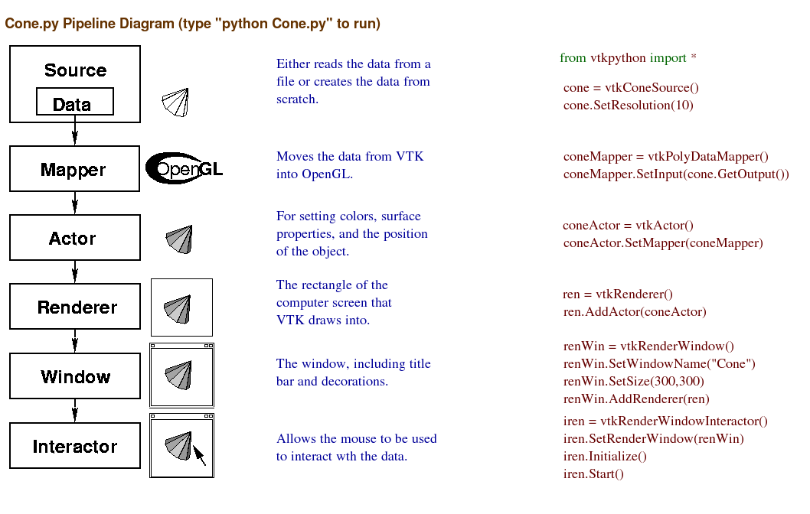
We will replace these and write our own GL calls.
We will re-use these.

Slide 9
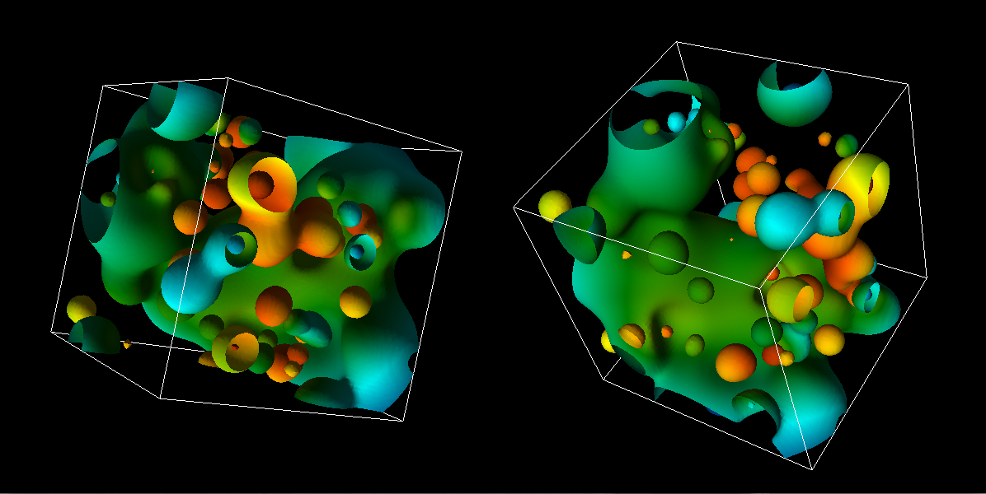
Project #2A (8%), Due Feb. 23rd
Goal: OpenGL program that does regular colors and textures
New VTK-based project2A.cxx
New CMakeLists.txt (but same as old ones)

Slide 10
Hints
I recommend you “walk before you run” & “take small bites”. OpenGL can be very punishing. Get a picture up and then improve on it. Make sure you know how to retreat to your previously working version at every step.
OpenGL “state thrashing” is common and tricky to debug.
Get one window working perfectly.
Then make the second one work perfectly.
Then try to get them to work together.
Things often go wrong, when one program leaves the OpenGL state in a way that doesn’t suit another renderer.

Slide 11
Hints
MAKE MANY BACKUPS OF YOUR PROGRAM
USE VTK 6
If you are having issues on your laptop with a GL program, then use Room 100
(There’s only 2 of these projects)

Slide 12
How to do colors (traditional)…
The Triangle class now has a “fieldValue” data member, which ranges between 0 and 1.
You will map this to a color using the GetColorMap function.
GetColorMap returns 256 colors.
Mappings
A fieldValue value of 0 should be mapped to the first color
A fieldValue value of 1 should be mapped to the 255th color.
Each fieldValue in between should be mapped to the closest color of the 256, but interpolation of colors is not required.

Slide 13
How to do colors (texture)…
Same idea, but use texture infrastructure
(easier)

Slide 14
Final Projects
541: everyone should do a self-defined project
441: your choice
Do a self-defined project
Do a pre-defined project

Slide 15
(DRAFT) Pre-defined projects
Hoping to have prompts up by Thursday Feb 28th
Likely topics:
2 WebGL projects
3 shader programs
GPU programming
Blender
Possible topics:
Vulcan
Computer vision (?)

Slide 16
Self-defined projects
Write a screen saver
Write a SIMPLE video game
Make a movie
Model something
Advanced computer graphics effects
Example: collision detection
Example: ray tracing
Example: volume rendering
Example: physics-based rendering

Slide 17
Process
Send me a proposal by Saturday March 2nd
The proposal should be for ~24 hours of work
I will send feedback (too much, too little)
If you don’t send a proposal, then it is assumed that you are doing the pre-defined projects

Slide 18
Transforms in GL

Slide 19
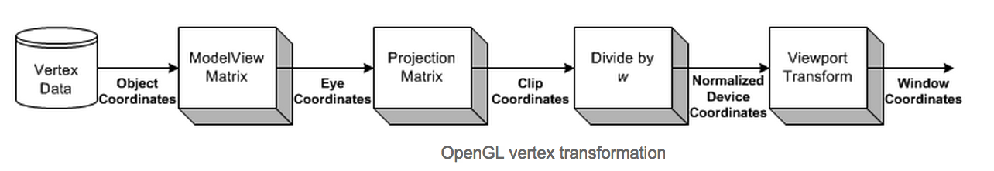
ModelView and Projection Matrices
New for us
Familiar for us
ModelView idea: two purposes … model and view
Model: extra matrix, just for rotating, scaling, and translating geometry.
How could this be useful?
View: Cartesian to Camera transform
(We will focus on the model part of the modelview matrix now & come back to others later)

Slide 20
SLIDE REPEAT: Our goal
Add additional transforms here….
O
O
World space:
Triangles in native Cartesian coordinates
Camera located anywhere
Camera space:
Camera located at origin, looking down -Z
Triangle coordinates relative to camera frame
z
y
x
Image space:
All viewable objects within
-1 <= x,y,z <= +1
Screen space:
All viewable objects within
-1 <= x, y <= +1
Device space:
All viewable objects within
0<=x<=width, 0 <=y<=height

Slide 21
ModelView and Projection Matrices
New for us
Familiar for us
ModelView idea: two purposes … model and view
Model: extra matrix, just for rotating, scaling, and translating geometry.
How could this be useful?
View: Cartesian to Camera transform
(We will focus on the model part of the modelview matrix now & come back to others later)

Slide 22
Common commands for modifying model part of ModelView matrix
glTranslate
glRotate
glScale

Slide 23
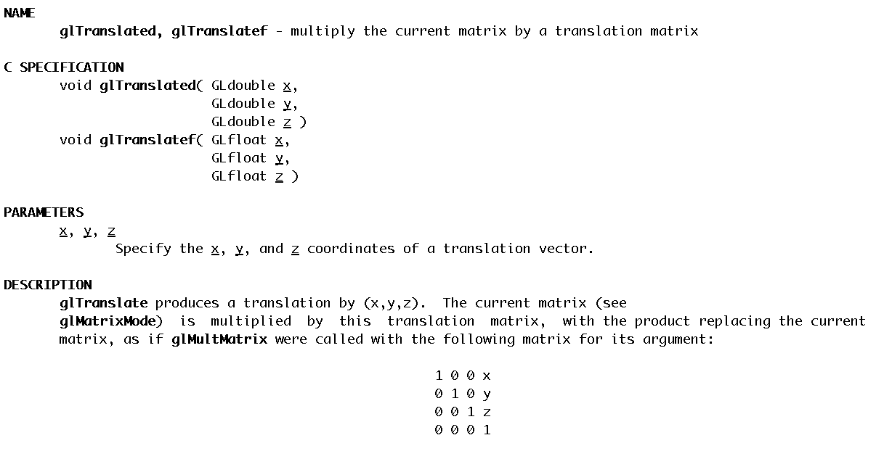
glTranslate
Note: this matrix transposed
from what we did earlier

Slide 24
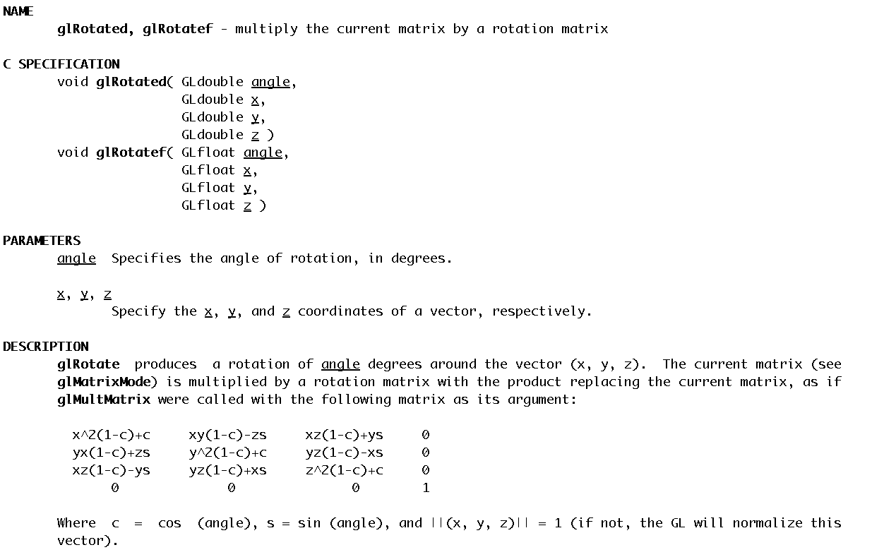
glRotate

Slide 25
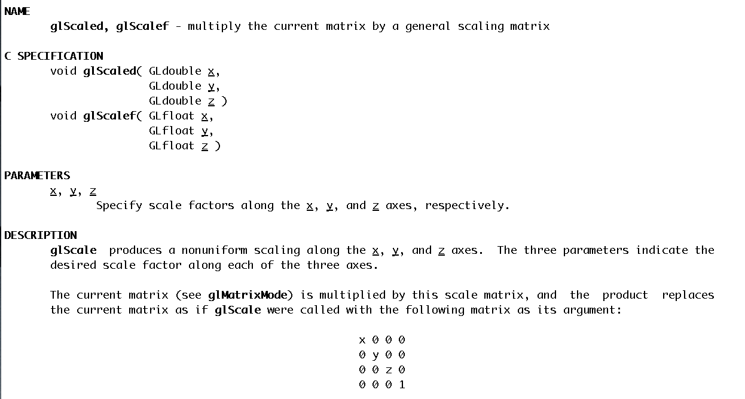
glScale

Slide 26
How do transformations combine?
glScale(2, 2, 2)
glTranslate(1, 0, 0)
glRotate(45, 0, 1, 0)
Rotate by 45 degrees around (0,1,0), then translate in X by 1, then scale by 2 in all dimensions.
(the last transformation is applied first)

Slide 27
Which of two of these three are the same?
Choice A:
glScalef(2, 2, 2);
glTranslate(1, 0, 0);
Choice B:
glTranslate(1, 0, 0);
glScalef(2, 2, 2);
Choice C:
glTranslate(2, 0, 0);
glScalef(2, 2, 2);

Slide 28
ModelView usage
dl = GenerateTireGeometry();
glCallList(dl); // place tire at (0, 0, 0)
glTranslatef(10, 0, 0);
glCallList(dl); // place tire at (10, 0, 0)
glTranslatef(0, 0, 10);
glCallList(dl); // place tire at (10, 0, 10)
glTranslatef(-10, 0, 0);
glCallList(dl); // place tire at (0, 0, 10)
Each glTranslatef call updates the state of the ModelView matrix.

Slide 29
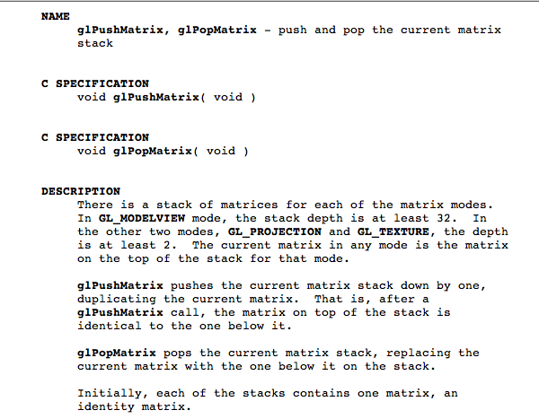
glPushMatrix, glPopMatrix

Slide 30
glPushMatrix and glPopMatrix
dl = GenerateTireGeometry();
glCallList(dl); // place tire at (0, 0, 0)
glPushMatrix();
glTranslatef(10, 0, 0);
glCallList(dl); // place tire at (10, 0, 0)
glPopMatrix();
glPushMatrix();
glTranslatef(0, 0, 10);
glCallList(dl); // place tire at (10, 0, 10) (0, 0, 10)
glPopMatrix();
Why is this useful?

Slide 31
Matrices in OpenGL
OpenGL maintains matrices for you and provides functions for setting matrices.
There are four different modes you can use:
Modelview
Projection
Texture
Color (rarely used, often not supported)
You control the mode using glMatrixMode.

Slide 32
Matrices in OpenGL (cont’d)
The matrices are the identity matrix by default and you can modify them by:
1) setting the matrix explicitly
2) using OpenGL commands for appending to the matrix
You can have >= 32 matrices for modelview, >=2 for others

Slide 33
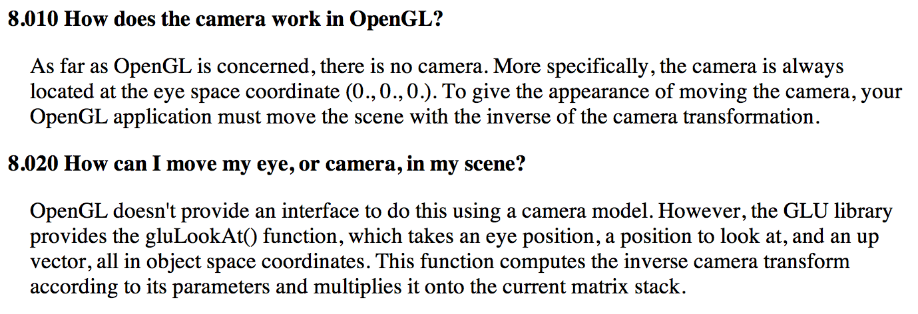
The Camera Transformation
Source: www.opengl.org/archives/resources/faq/technical/viewing.htm

Slide 34
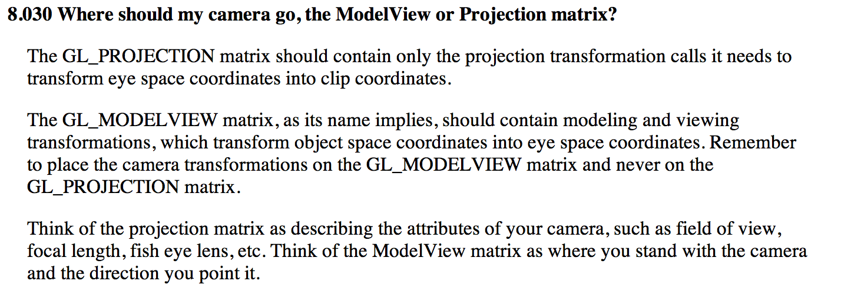
The Camera Transformation
Source: www.opengl.org/archives/resources/faq/technical/viewing.htm

Slide 35
How do you put the Camera Transform in the ModelView matrix?
No single GL call.
Options are:
(1) you do it yourself (i.e., calculate matrix and load it into OpenGL)
(2) you use somebody’s code, i.e., gluLookAt
(3) you use a combination of glRotatef, glScalef, and glTranslatef commands.

Slide 36
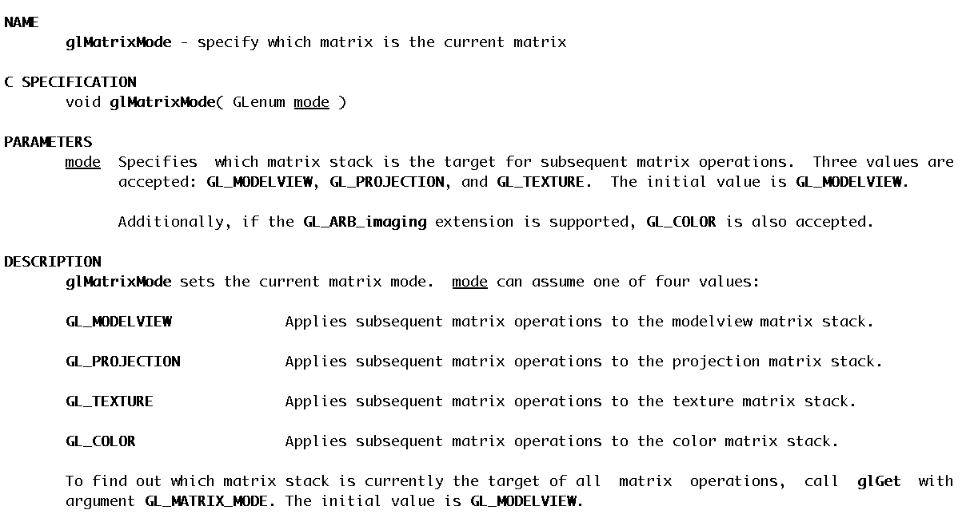
glMatrixMode

Slide 37
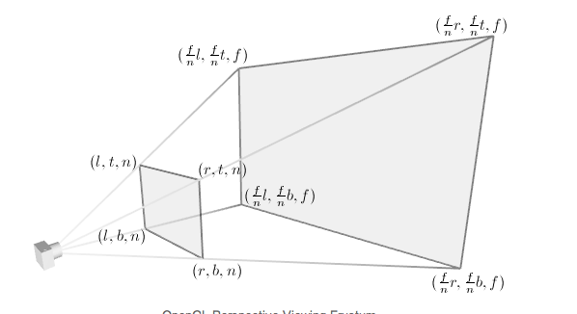
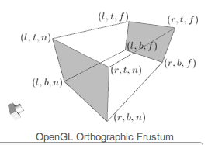
How do you put the projection transformation in GL_PROJECTION?
Two options:
glFrustum() (perspective projection)
glOrtho() (orthographic projection)

Slide 38
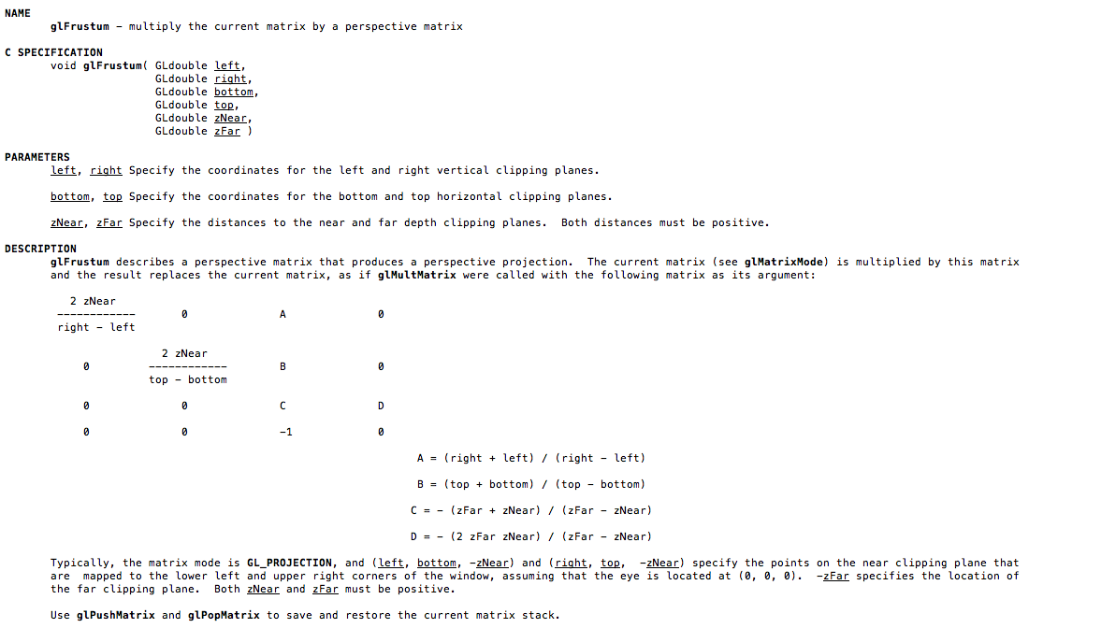
glFrustum

Slide 39
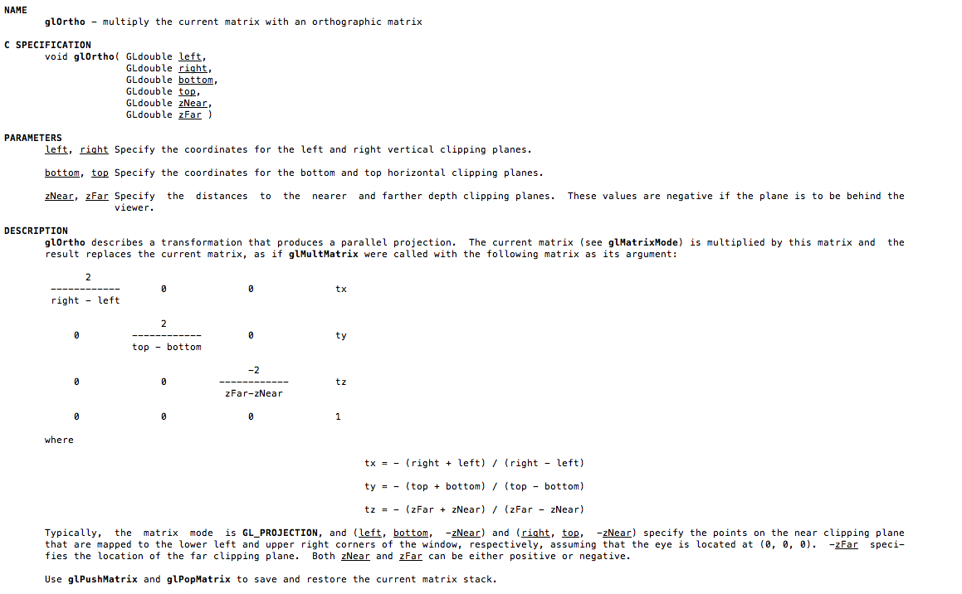
glOrtho

Slide 40
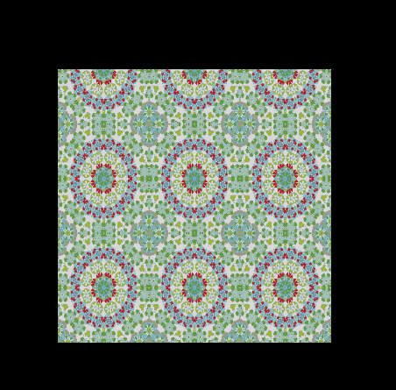
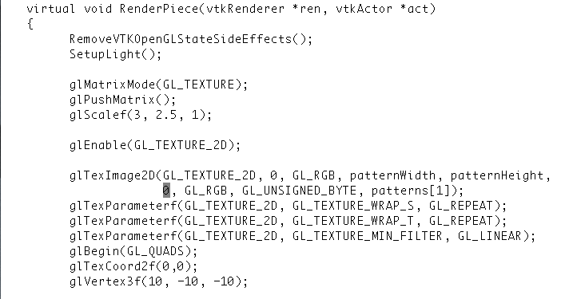
glMatrixMode(GL_TEXTURE)

Slide 41
Project 2B

Slide 42
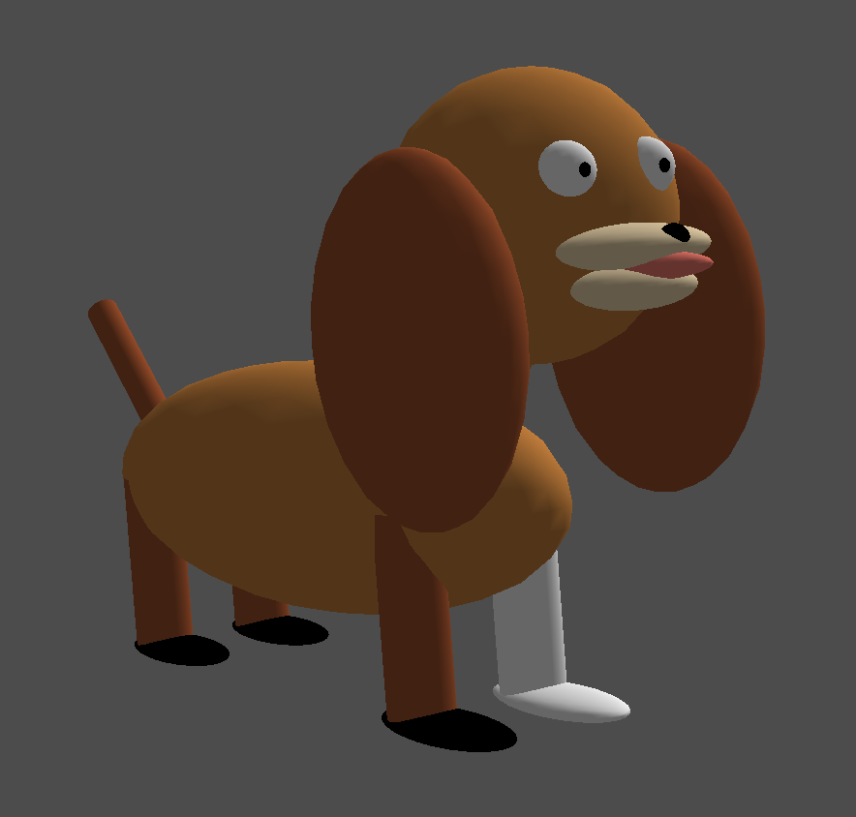
Project #2B (7%), Due Weds Feb 27th
Goal: modify ModelView matrix to create dog out of spheres and cylinders
New code skeleton: “project2B.cxx”
No geometry file needed.
You will be able to do this w/ glPush/PopMatrix, glRotatef, glTranslatef, and glScalef.

Slide 43
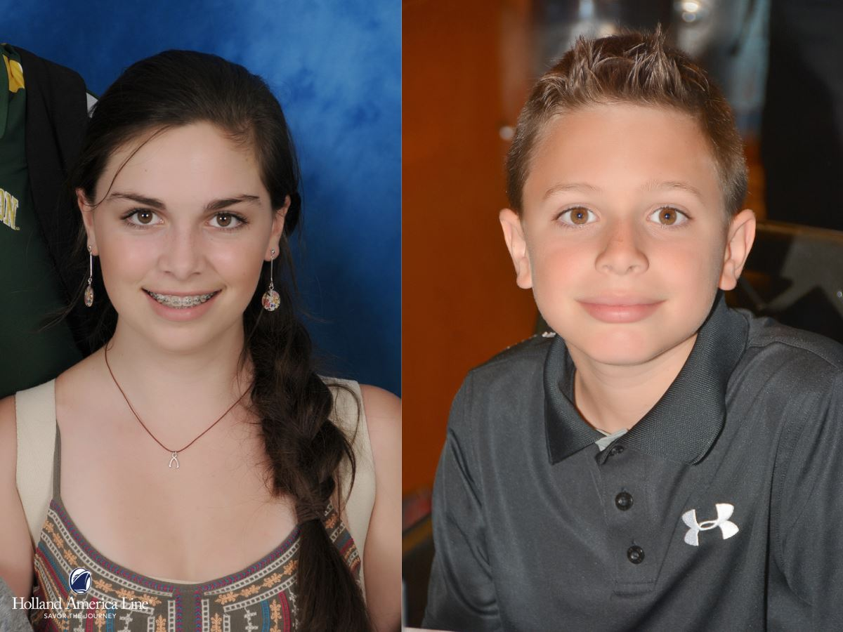
Project #2B (7%), Due Weds Feb 27th
Goal: modify ModelView matrix to create dog out of spheres and cylinders
New code skeleton: “project2B.cxx”
No geometry file needed.
You will be able to do this w/ glPush/PopMatrix, glRotatef, glTranslatef, and glScalef.

Slide 44
Contents of project2B.cxx
Routine for generating spheres
Routine for generating cylinders
Routine for generating head, eyes, and pupils

Slide 45
What is the correct answer?
The correct answer is:
Something that looks like a dog
No obvious problems with output geometry.
Something that uses the sphere and cylinder classes.
If you use something else, please clear it with me first.
I may fail your project if I think you are using outside resources that make the project too easy.
Something that uses rotation for the neck and tail.
Aside from that, feel free to be as creative as you want … color, breed, etc.

Slide 46
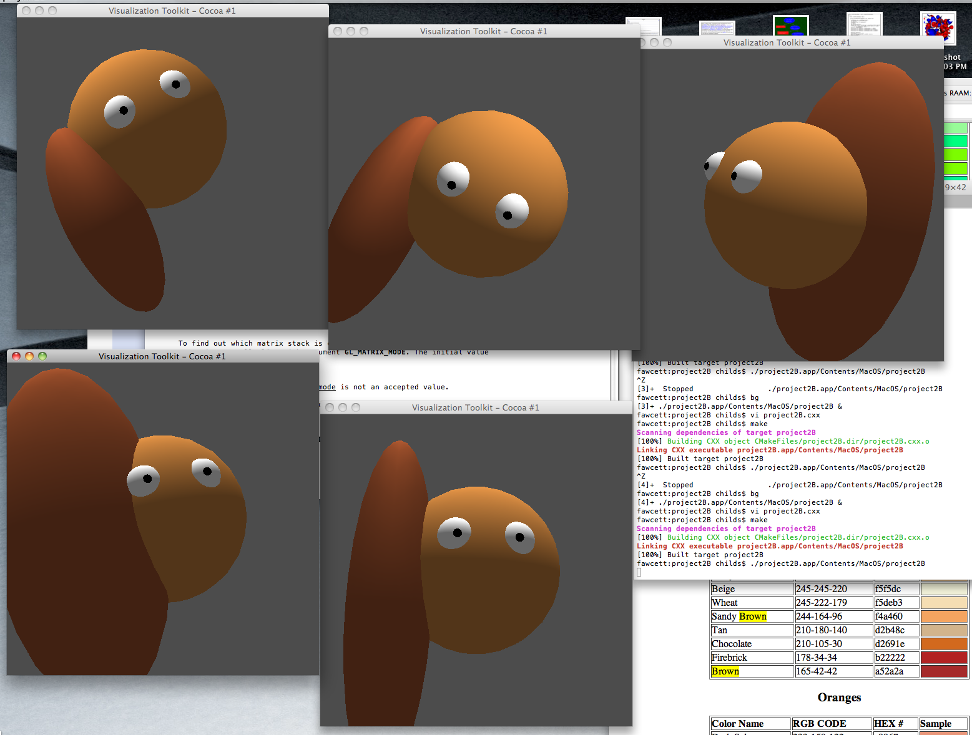

Slide 47
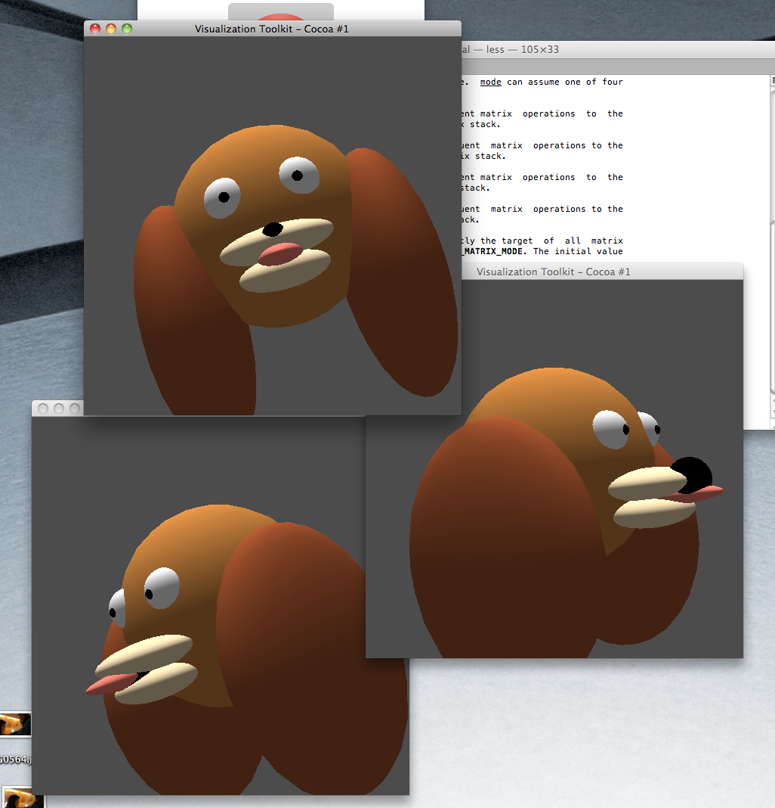

Slide 48
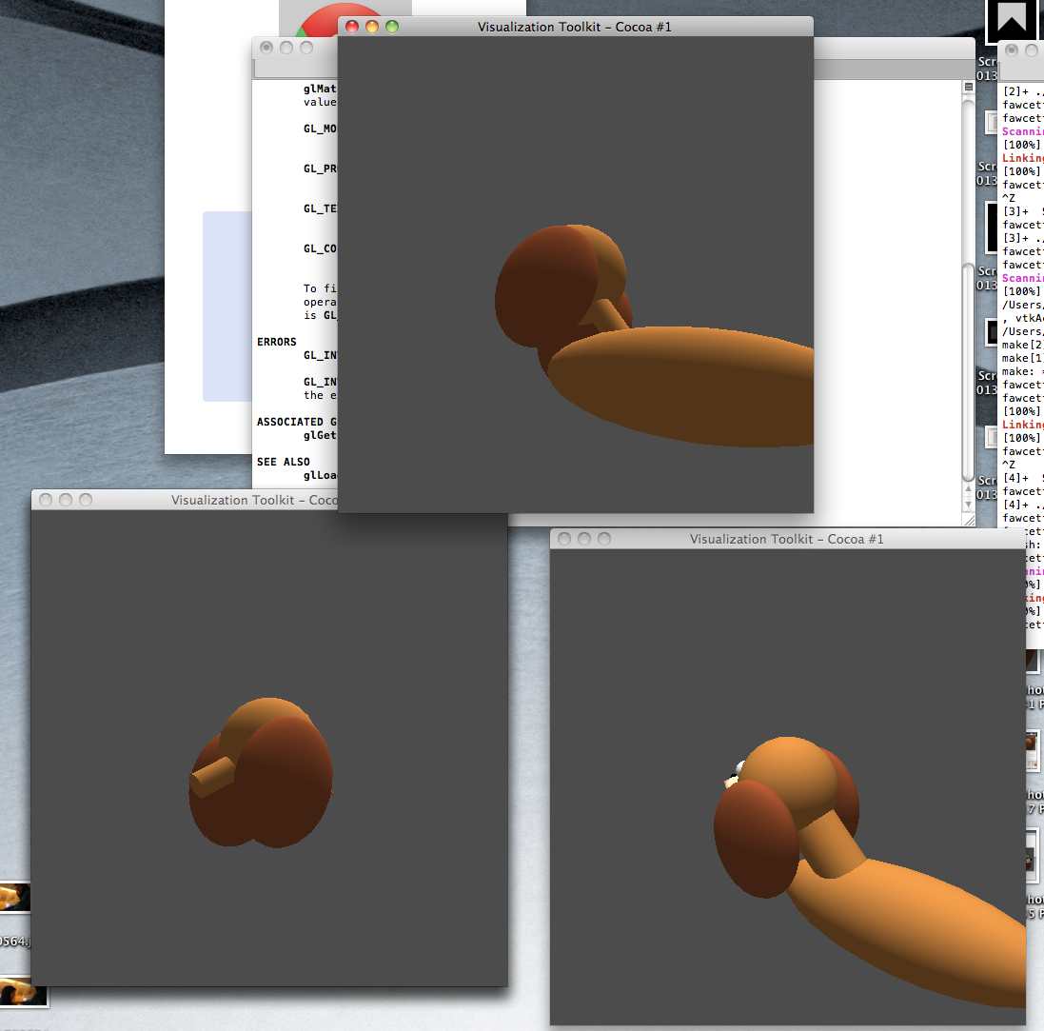

Slide 49
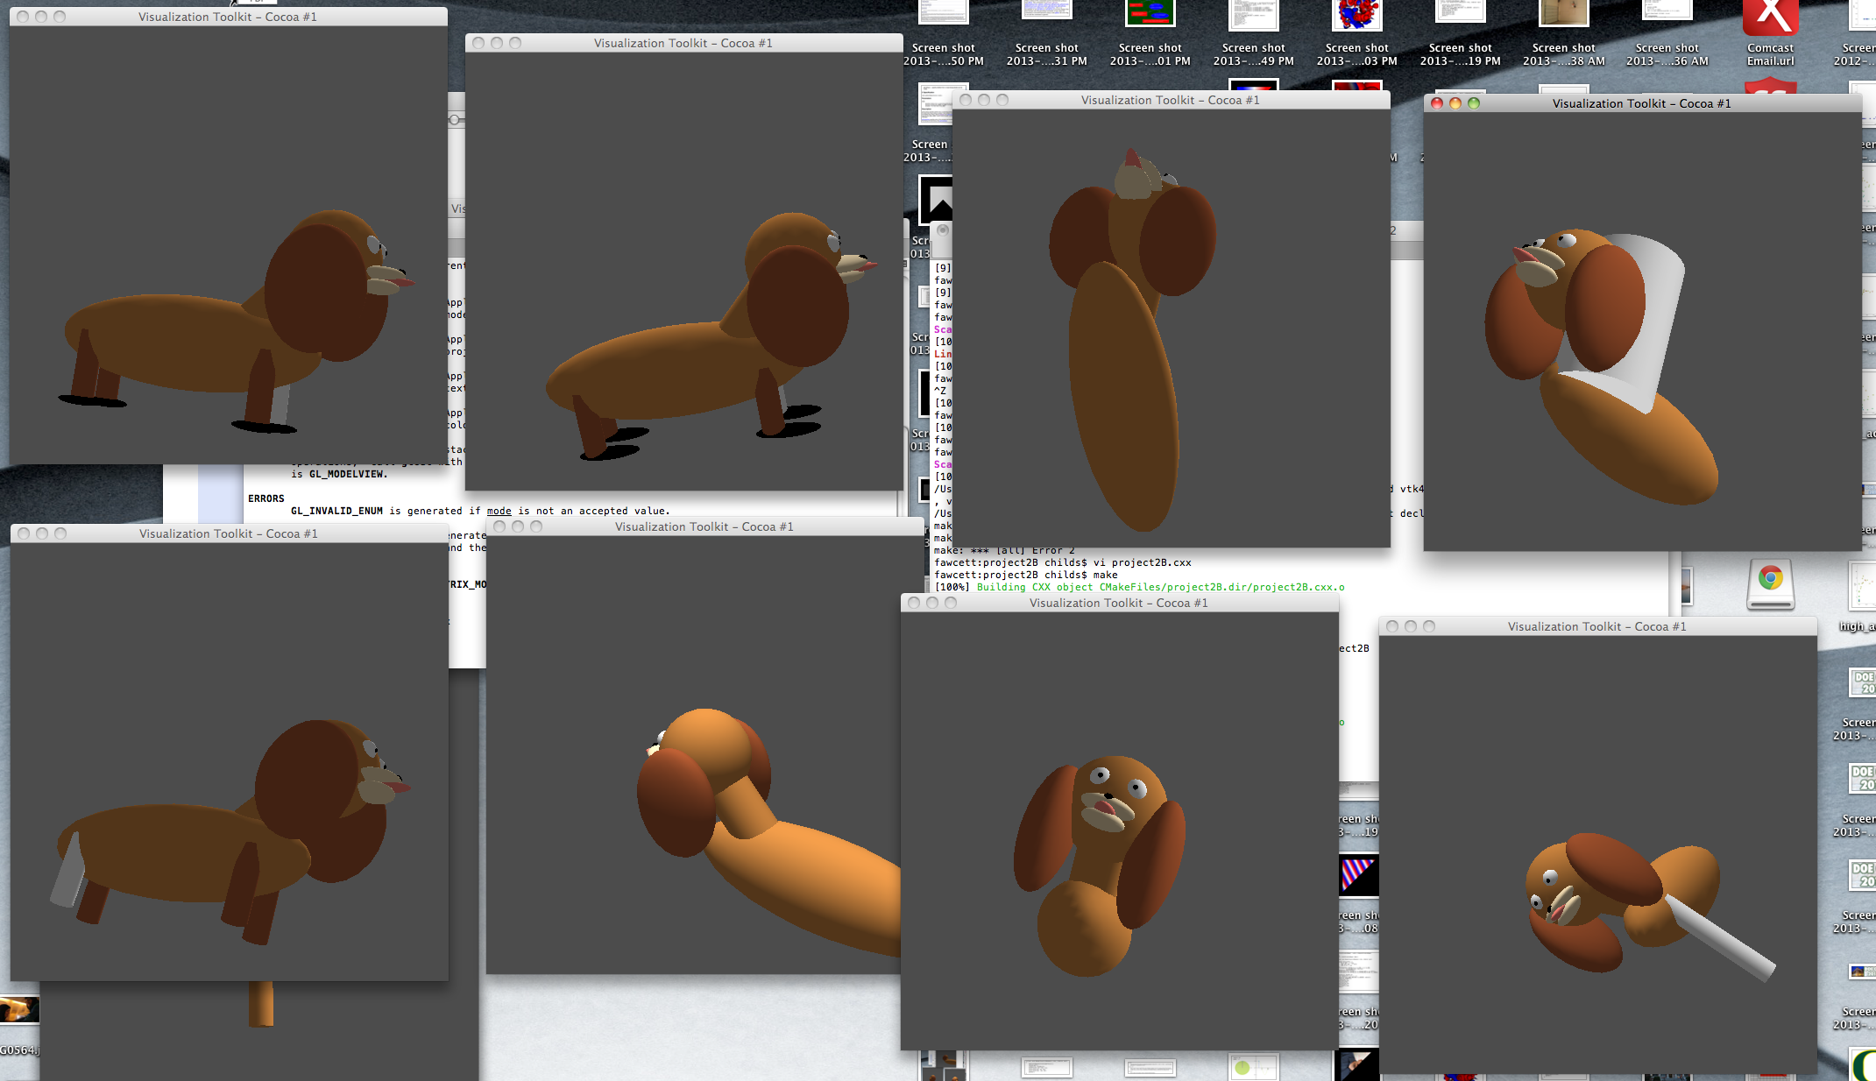

Slide 50
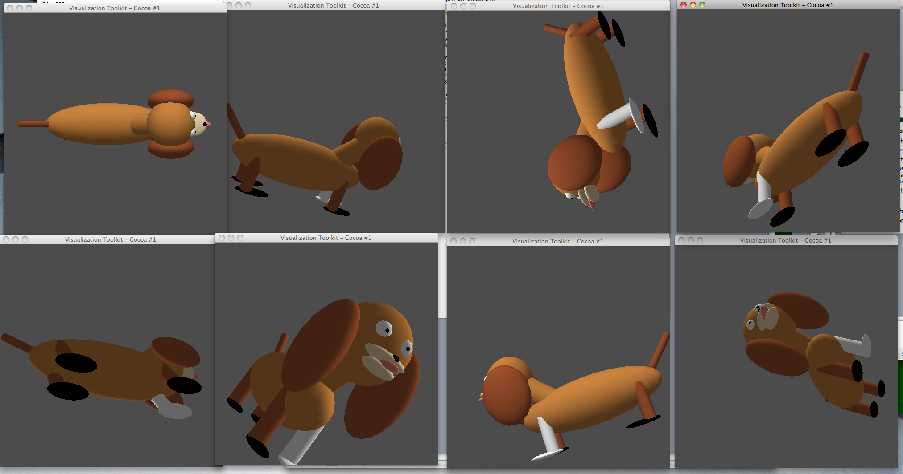
For your reference: my dog

Slide 51
Transparent Geometry

Slide 52
Compositing and Blending
Ed Angel
Professor of Computer Science, Electrical and Computer Engineering, and Media Arts
University of New Mexico

Slide 53

Opacity and Transparency
Opaque surfaces permit no light to pass through
Transparent surfaces permit all light to pass
Translucent surfaces pass some light
translucency = 1 – opacity (α)
opaque surface α =1

Slide 54
Transparency
If you have an opaque red square in front of a blue square, what color would you see?
Red
If you have a 50% transparent red square in front of a blue square, what color would you see?
Purple
If you have a 100% transparent red square in front of a blue square, what color would you see?
Blue

Slide 55
(One) Formula For Transparency
Front = (Fr,Fg,Fb,Fa)
a = alpha, transparency factor
Sometimes percent
Typically 0-255, with 255 = 100%, 0 = 0%
Back = (Br,Bg,Bb,Ba)
Equation = (Fa*Fr+(1-Fa)*Br, Fa*Fg+(1-Fa)*Bg, Fa*Fb+(1-Fa)*Bb, Fa+(1-Fa)*Ba)

Slide 56
Transparency
If you have an 25% transparent red square (255,0,0) in front of a blue square (0,0,255), what color would you see (in RGB)?
(192,0,64)
If you have an 25% transparent blue square (0,0,255) in front of a red square (255,0,0), what color would you see (in RGB)?
(64,0,192)

Slide 57
Implementation
Per pixel storage:
RGB: 3 bytes
Alpha: 1 byte
Z: 4 bytes
Alpha used to control blending of current color and new colors

Slide 58
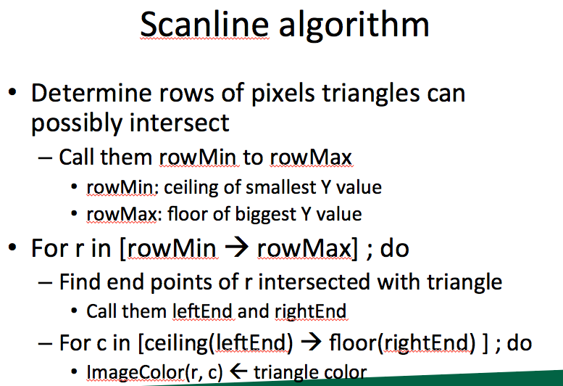
Vocab term reminder: fragment
Fragment is the contribution of a triangle to a single pixel
Almost certain to use
term “fragment” on midterm
and expect that you know
what it means

Slide 59
Examples
Imagine pixel (i, j) has:
RGB = 255/255/255
Alpha=255
Depth = -0.5
And we contribute fragment:
RGB=0/0/0
Alpha=128
Depth = -0.25
What do we get?
Answer: 128/128/128, Z = -0.25
What’s the alpha?

Slide 60
Examples
Imagine pixel (i, j) has:
RGB = 255/255/255
Alpha=128
Depth = -0.25
And we contribute fragment:
RGB=0/0/0
Alpha=255
Depth = -0.5
What do we get?
Answer: (probably) 128/128/128, Z = -0.25
What’s the alpha?

Slide 61
System doesn’t work well for transparency
Contribute fragments in this order:
Z=-0.1
Z=-0.9
Z=-0.5
Z=-0.4
Z=-0.6
Model is too simple. Not enough info to resolve!

Slide 62
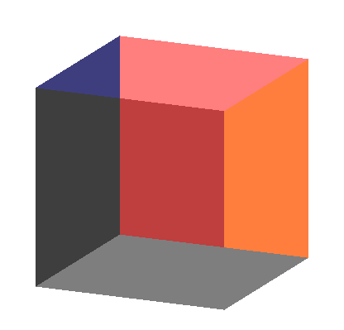
Order Dependency
Is this image correct?
Probably not
Polygons are rendered
in the order they pass
down the pipeline
Blending functions
are order dependent

Slide 63
How do you sort?
1) Calculate depth of each triangle center.
2) Sort based on depth
Not perfect, but good
In practice: sort along X, Y, and Z and use “dominant axis” and only do “perfect sort” when rotation stops

Slide 64
But there is a problem…
(0, 1, -0.4)
(0, 1.5, -0.4)
(-1, -1, -0.3)
(1, -1, -0.5)
(-2, -1.5, -0.5)
(2, -1.5, -0.3)

Slide 65
Depth Peeling
a multi-pass technique that renders transparent polygonal geometry without sorting
Pass #1:
render as opaque, but note opacity of pixels placed on top
treat this as “top layer”
save Z-buffer and treat this as “max”
Pass #2:
render as opaque, but ignore fragments beyond “max”
repeat, repeat…

